Slide 1

5 Reasons why Spark is in demand! Presenter – Sagar

Slide 2





Reasons why Spark is in Demand
Let us have a quick poll, do you know the following topics?
Reason #1 : Low Latency
Reason #2 : Streaming Support
Reason #3 : Machine Learning and Graph
Reason #4 : Data Frame API introduction
Reason #5 : Spark integration with Hadoop

Slide 3
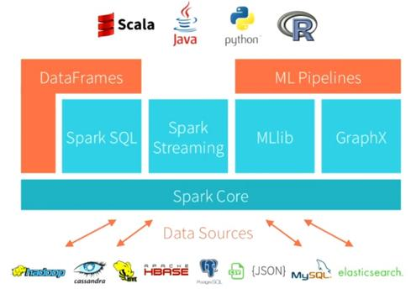
Spark Architecure
Utility for continuous ingestion of data
Graph programming
Spark interface
For RDBMS lovers
Machine Learning
Library

Slide 4
Low Latency

Slide 5
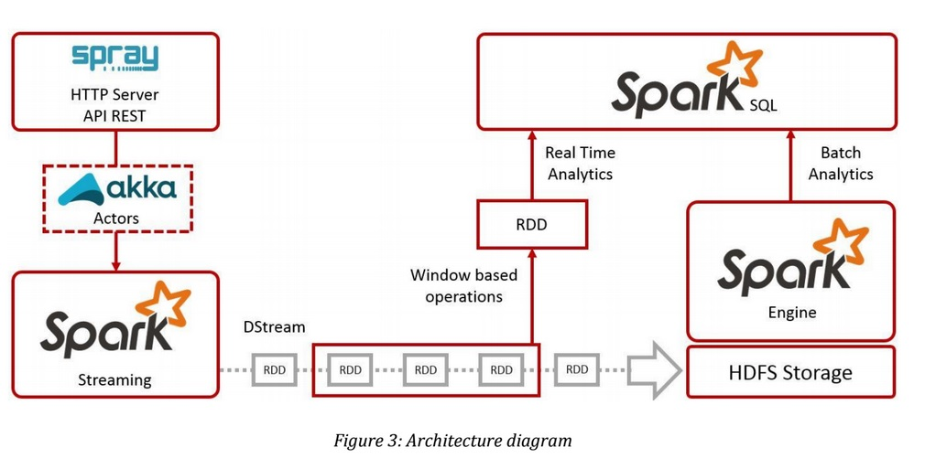

Sparks Cuts Down Read/Write I/O To Disk
Spark tries to keep things in-memory of its distributed workers, allowing for significantly faster/lower-latency computations, whereas MapReduce keeps shuffling things in and out of disk.
Spark is good for data that fits In-Memory and Off-Memory

Slide 6
Time taken for a System to Sort 100 TB Of Data
The previous world record was 72 minutes, set by Yahoo using a Hadoop MapReduce cluster of 2100 nodes
Using Spark on 206 EC2 nodes, it took only 23 minutes.
Spark sorted the same data 3X faster using 10X fewer machines

Slide 7
Streaming Support

Slide 8
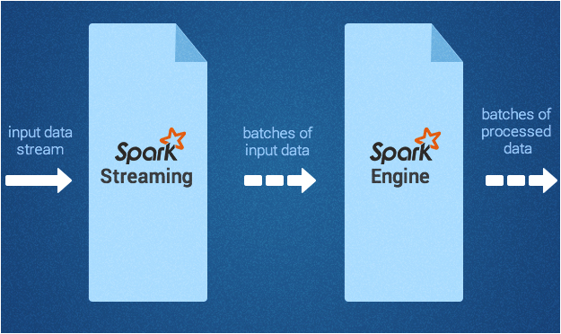
Event processing
Used for processing the real-time streaming data.
It uses the DStream which is a series of RDDs, for processing the continuous real-time data.
The Spark Streaming API closely matches that of the Spark Core
The Spark Streaming API closely matches that of the Spark Core

Slide 9
Machine Learning and graph
implementation with DAG

Slide 10
Machine Learning
MLlib, a machine learning library
Classification
Regression
Clustering
Collaborative filtering
and so on
Some of the algorithms also work with streaming data, such as linear regression using ordinary least squares or k-means clustering

Slide 11
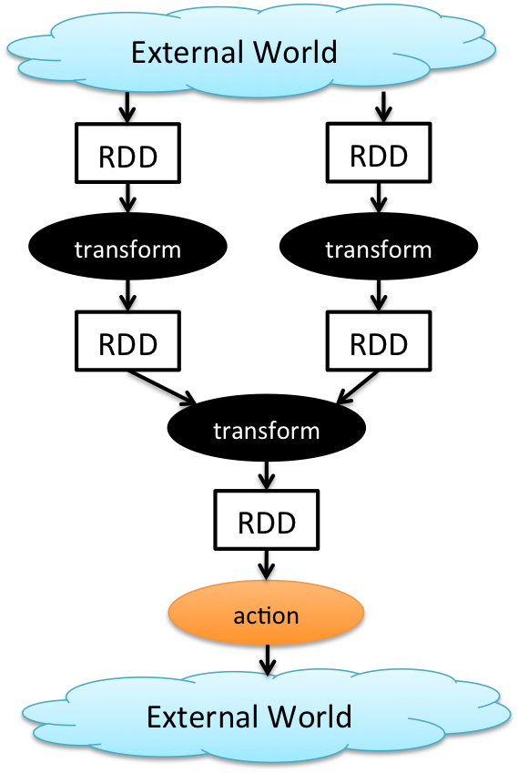
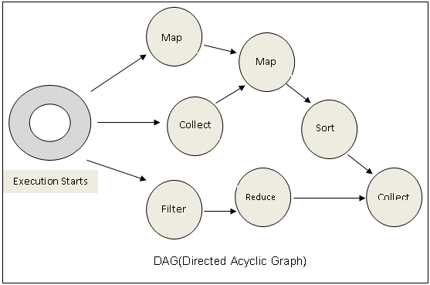
Cyclic Data Flows
All jobs in spark comprise a series of operators and run on a set of data.
All the operators in a job are used to construct a DAG (Directed Acyclic Graph).
The DAG is optimized by rearranging and combining operators where possible.

Slide 12
GraphX
Component for graphs and graph-parallel computation
Extends the Spark RDD by introducing a new Graph abstraction
Graph Algorithms
PageRank
Connected Components
Triangle Counting

Slide 13
Support for Data Frames

Slide 14
DataFrame
As Spark continues to grow, it wants to enable wider audiences beyond “big data” engineers to leverage the power of distributed processing.
Inspired by DataFrames in R and Python (pandas)
DataFrames API is designed to make big data processing on tabular data easier
DataFrame is a distributed collection of data organized into named columns.
Provides operations to filter, group, or compute aggregates, and can be used with Spark SQL.
Can be constructed from structured data files, existing RDDs, tables in Hive, or external databases.

Slide 15
DataFrame features
Ability to scale from KBs to PBs
Support for a wide array of data formats and storage systems
State-of-the-art optimization and code generation through the spark SQL catalyst optimizer
Seamless integration with all big data tooling and infrastructure via spark
APIs for python, java, scala, and R (in development via sparkr)

Slide 16
Spark integration with Hadoop

Slide 17
Spark Execution Platforms
Spark can leverage the resource negotiator of Hadoop framework i.e. YARN
Spark workloads can make use of Symphony scheduling policies and execute via YARN
Spark execution modes
Standalone
Mesos
HDFS

Slide 18
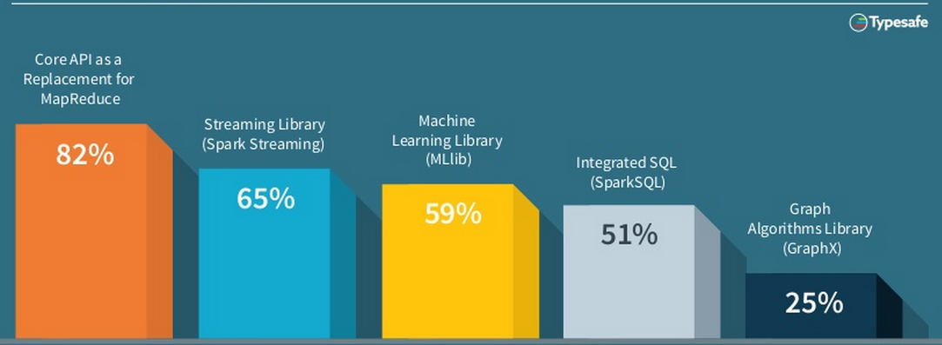
Spark Features/Modules in Demand

Slide 19

New Features In 2015
Data Frames →
Similar API to data frames in R and Pandas
Automatically optimised via Spark SQL
Released in Spark 1.3
SparkR →
Released in Spark 1.4
Exposes DataFrames, RDD’s & ML library in R
Machine Learning Pipelines →
High Level API
Featurization
Evaluation
Model Tuning
External Data Sources →
Platform API to plug Data-Sources into Spark
Pushes logic into sources

Slide 20
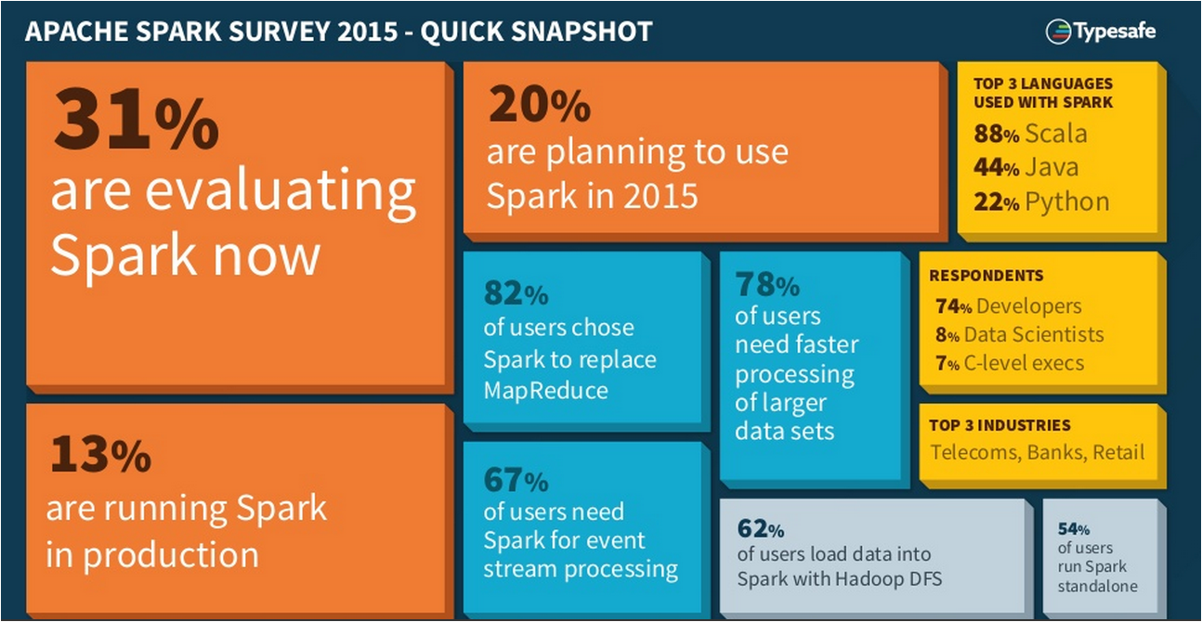
Spark overview

Slide 21
Certifications

Slide 22

Certifications
Get Certified in Apache Spark & Scala by Edureka
Go to www.edureka.co/apache-spark-scala-training
Batch starts from 26 October ( Weekday Batch )
Edureka's XX course:
Learn large-scale data processing by mastering concepts like Scala, RDD, Traits, OOPS and Spark SQL
Online Live Courses: 24 hours
Assignments: 32 hours
Project: 20 hours
Lifetime Access + 24 X 7 Support

Slide 23
Thank You
Questions/Queries/Feedback
Recording and presentation will be made available to you within 24 hours

